Slide 1

ModelIt!
Student Lesson
When Trees Become Matches
California's Burning Season and the Earth Systems That Fuel It

Slide 2
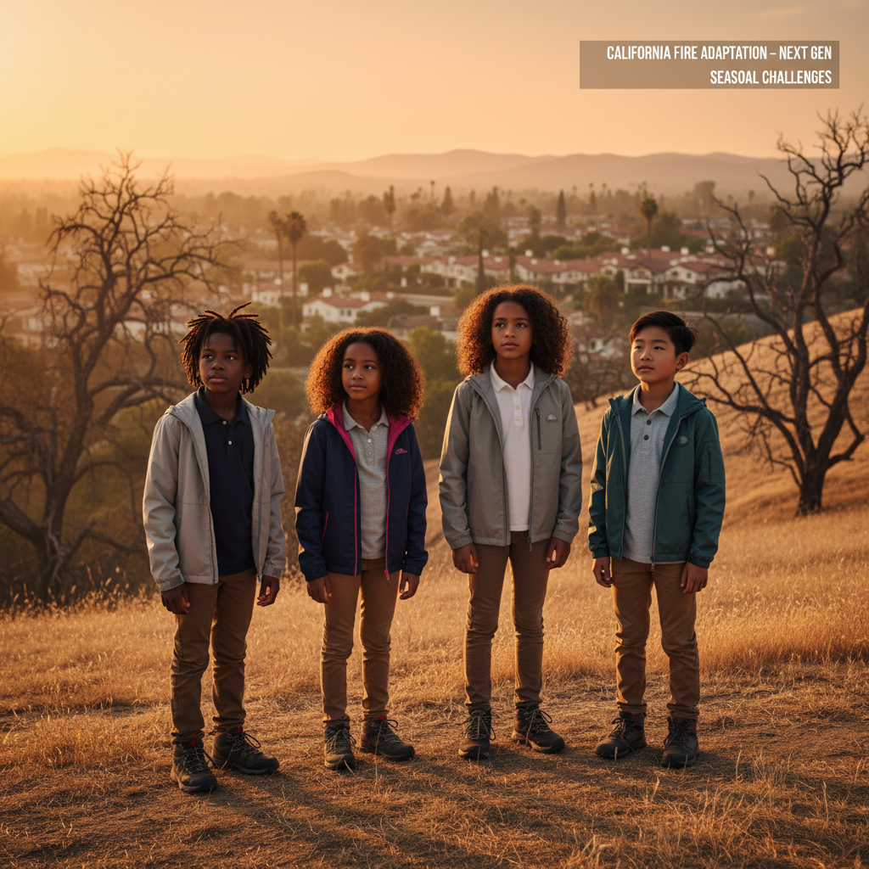
The Big Question
Why does California burn at the same time every year?

Slide 3

Today We Will Build a Model!
1. Identify the COMPONENTS (parts) of the California fire system
2. Connect them with RELATIONSHIPS (how they affect each other)
3. Run SIMULATIONS to see what happens during drought
4. Make PREDICTIONS about fire conditions

Slide 4
Activity 1: Sort the Components
Your components:
* Rainfall
* Dry Vegetation
* Wind
* Fire Spread
Sort them into INTERNAL and EXTERNAL!
[ModelIt Platform Screenshot - Sorting Activity]

Slide 5

Activity 2: Connect with Arrows
Draw arrows to show HOW components affect each other:
(+) POSITIVE: When one goes UP, the other goes UP
(-) NEGATIVE: When one goes UP, the other goes DOWN
Think: When RAINFALL goes UP, does DRY VEGETATION go UP or DOWN?

Slide 6
Activity 3: Run the Simulation!
Test these scenarios:
1. Drought: Turn RAINFALL OFF
2. Windy Day: Turn WIND ON
3. Fire Season: Both conditions!
Watch the graphs change!
[ModelIt Platform Screenshot - Simulation Results]

Slide 7
What Did We Discover?
* California's dry season = more fire risk
* Drought makes vegetation into FUEL
* Wind helps fire SPREAD faster
* These Earth systems work TOGETHER

Slide 8

STEM Challenge: Firebreak Engineers!
Your Mission:
Design firebreaks to protect Willow Creek from wildfire!
You learned: Removing DRY VEGETATION breaks the fire chain.
Now apply it like real engineers!

